Slide 1
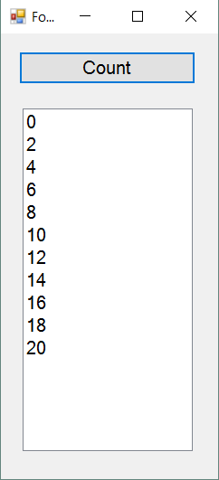
C++ Exercise 1
Use a for loop to count by 2’s
Build an button click handler that writes the sequence 0, 2, 4, … , 20 into a ListBox. Write one number on each line.
Notes:
Let’s make sure everything is working.
In this first example, we’ll just work with a form (more accurately the Form class), we won’t make any classes of our own.
When we do get around to making our own classes, we will see that the file structure and scoping is more complex than we have been used to in C# or Java.

Slide 2

C++ Class Exercise
Build an application with two Buttons and a Timer.
Every 100 msec, one button moves 5 pixels to the left, and the other button moves 5 pixels to the right.
When either button hits the edge of the form
That button turns green.
The timer stops
Upload to your GitBucket repo.
Notes:
Here’s today’s programming task. Just to remind your brain how it all works.
All the code you need to write should go in the timer’s tick event handler.
Not clear how much help this group will need, since they will have done Programming 1 and 2 in C#....

